Slide 1

Terraform basic
For Network Engineer

Slide 2





What is terraform?
Terraform is a tool for building, changing, and versioning infrastructure safely and efficiently.
Infrastructure as Code ( IAC)
Component of Terraform [ 3 component]
A provider is responsible for understanding API interactions and exposing resources
A Terraform resource describes one or more infrastructure objects, for example in an ACI Tenant, EPG, Contract etc.
A data object is used to read about existing resources.

Slide 3
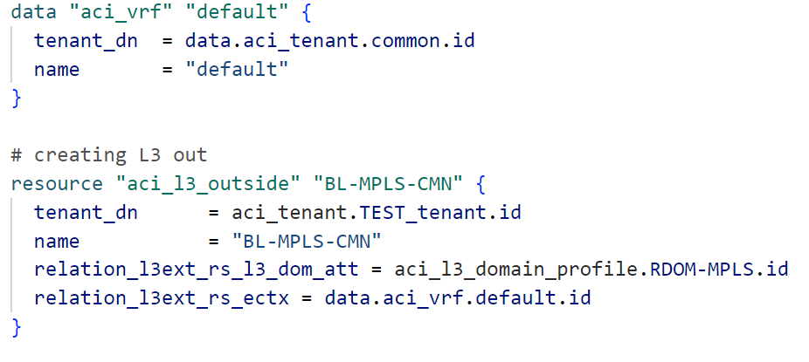


Provider and Data
provider
terraform {
required providers {
aci = {
source = "CiscoDevNet/aci"
version = "2.6.0"
}
}
}
provider "aci" {
username = "admin"
password = "admin"
url = "https://apic.com/"
insecure = true
}

Slide 4
RESOURCE
# Vlan pool
resource "aci_vlan_pool" "VLANS_MPLS" {
name = "VLANS_MPLS"
description = "From Terraform"
alloc_mode = "static"
}
resource "aci_ranges" "range_1" {
vlan_pool_dn = aci_vlan_pool.VLANS_MPLS.id
description = "From Terraform"
from = "vlan-200"
to = "vlan-210"
alloc_mode = "inherit"
role = "external"
}

Slide 5
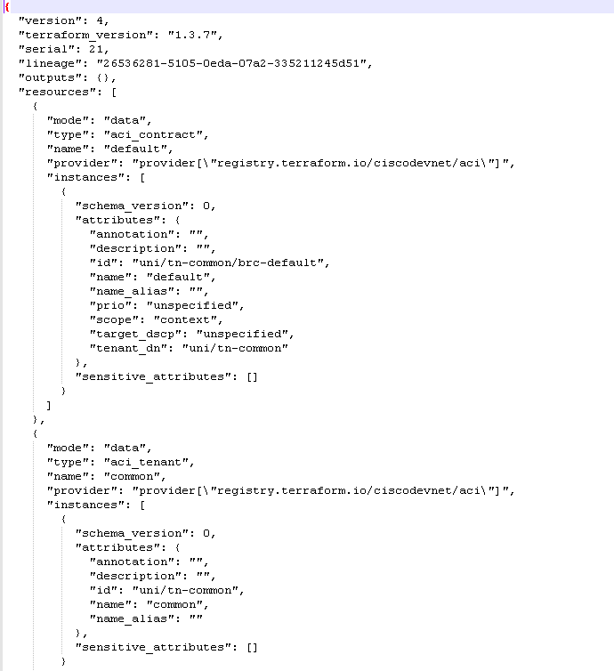
State Files
​​​​​​​In order for Terraform to know what changes need to be made to your infrastructure, it must keep track of the environment. This information is stored by default in a local file named “terraform.tfstate“
. State files can be stored locally or remotely like remote location S3 Bucket

Slide 6
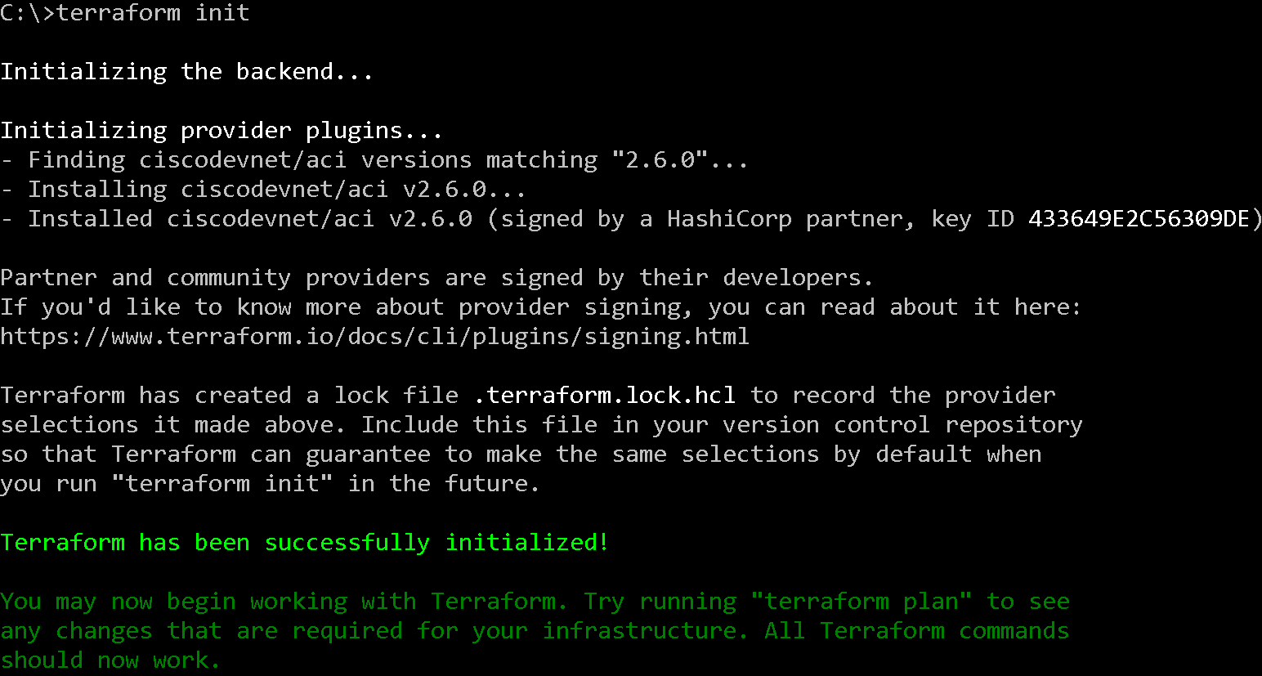
COMMANDS
terraform init
. Initializes a working directory containing Terraform configuration files
. It will download required plugins for providers

Slide 7
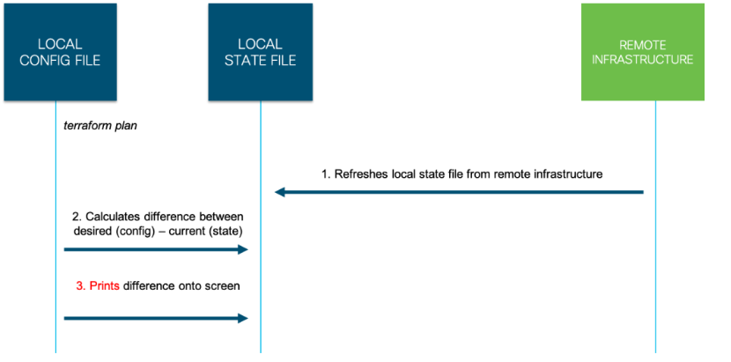
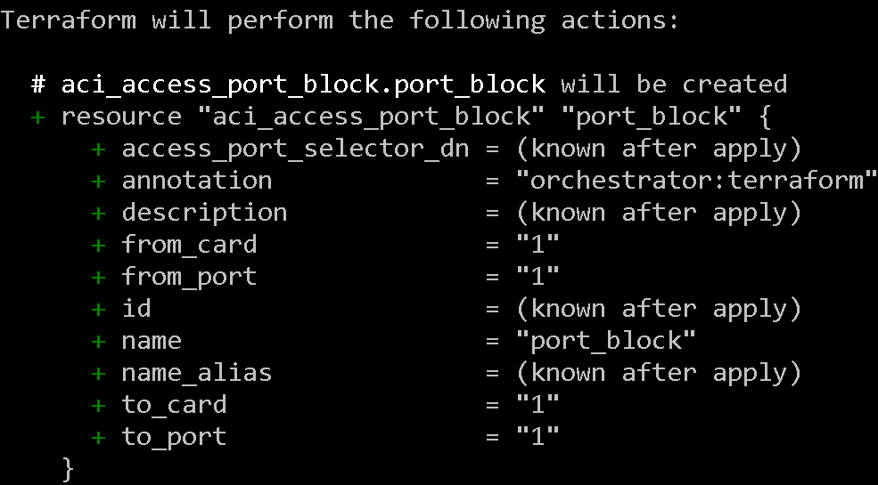
COMMANDS
terraform plan
. It create execution plan
. Will print the same on screen

Slide 8
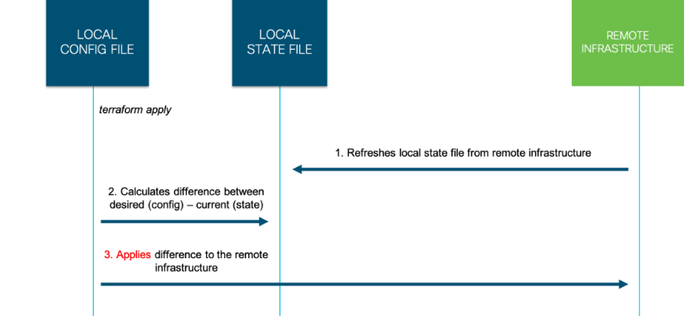
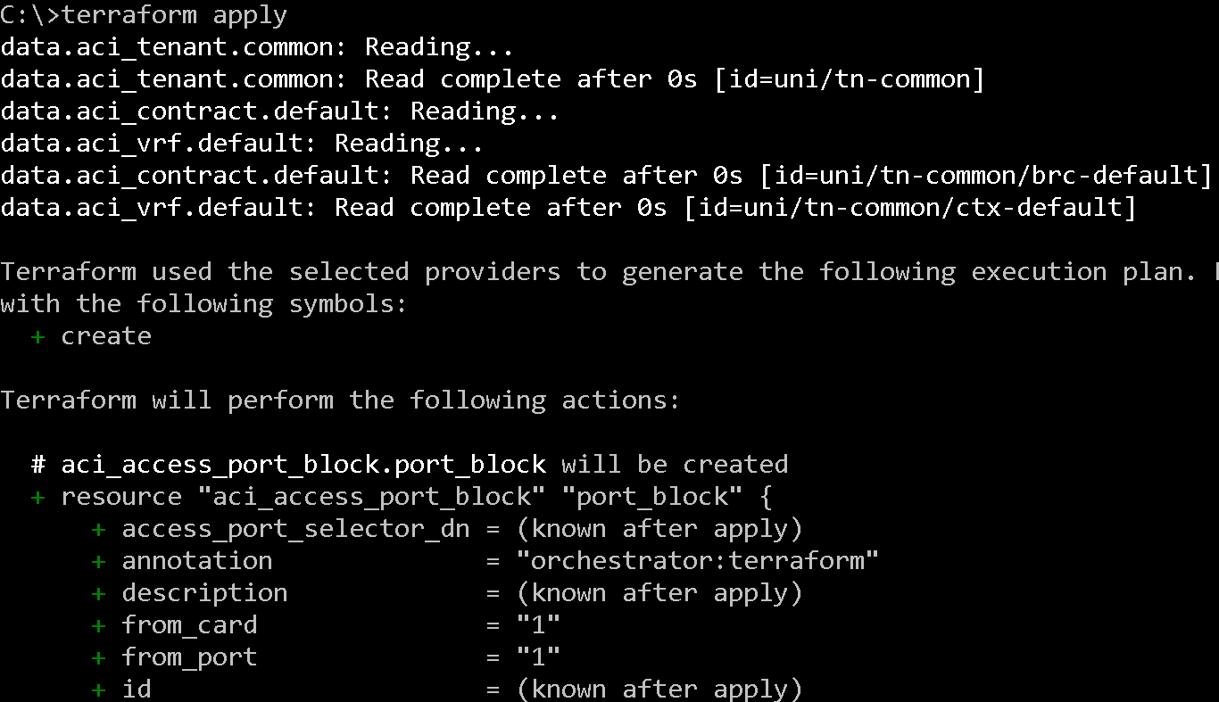
COMMANDS
terraform apply
. It will push the required changes to get the desired state

Slide 9
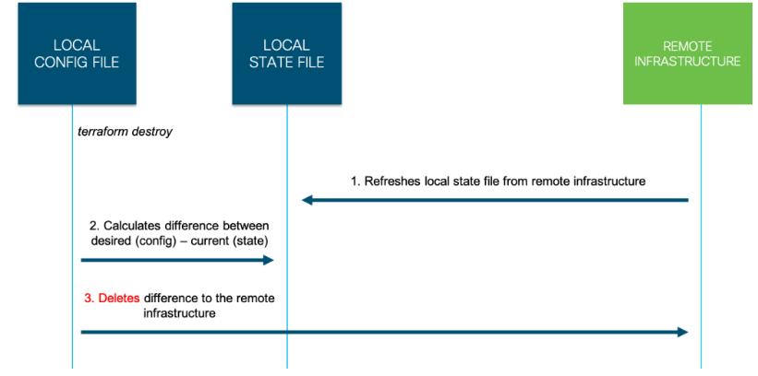
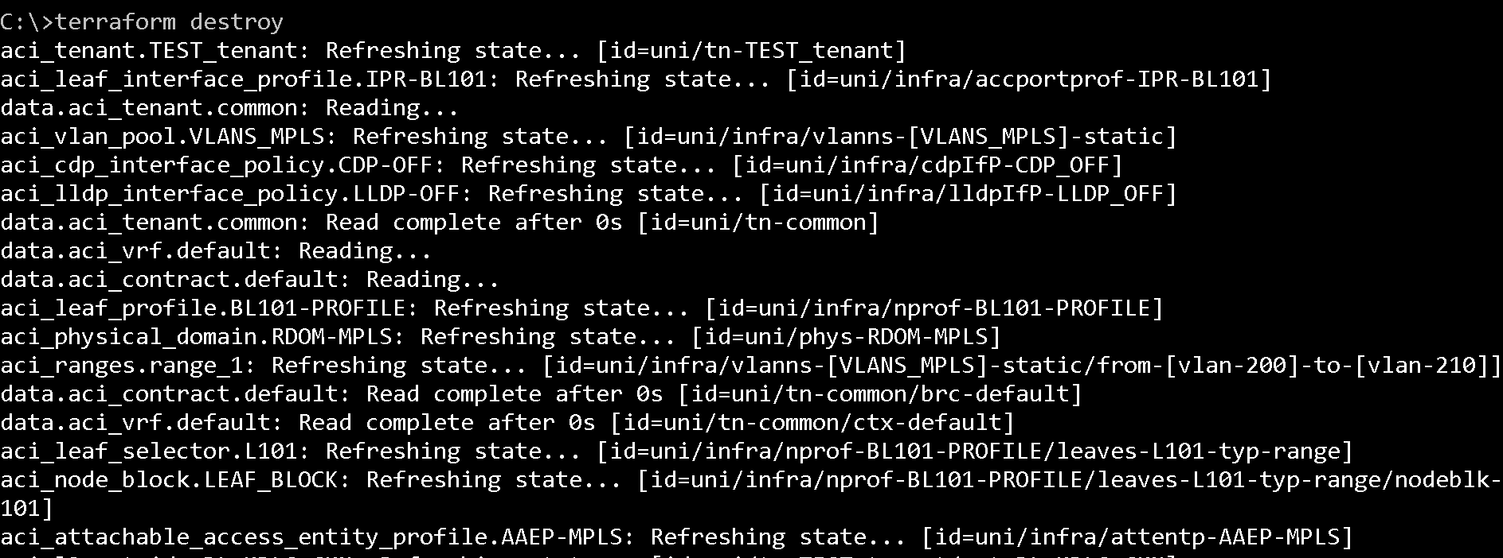
COMMANDS
terraform destroy
It will delete all the changes managed by terraform.

